Slide 1
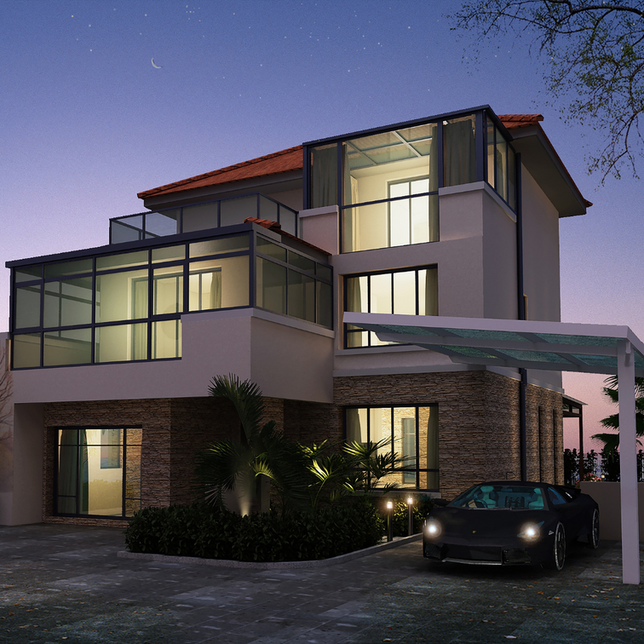
Dream Home Decision Making

Slide 2

Outline
Sample Data and Parameters
Mortgage Repayment Analysis
Income Analysis
Comparison
Mortgage Rate and Payment
Decision Making

Slide 3
Key Preferences
KEY PREFERENCES
Mortgage Rate | Min 4.0% - Max 4.7%
Monthly Repayment Capacity | Max $5,000
Amortisation Period | Min 150 months - 200 months
Purchasing Price Projected | Min $500,000 - Max $650,000
Parking Space | Min 3
Proximity to Public Facilities (Neighbourhood) | Yes
Number of Bedrooms | 3
Number of Bathrooms | 3
Exterior finish | Aluminium, Brick

Slide 4
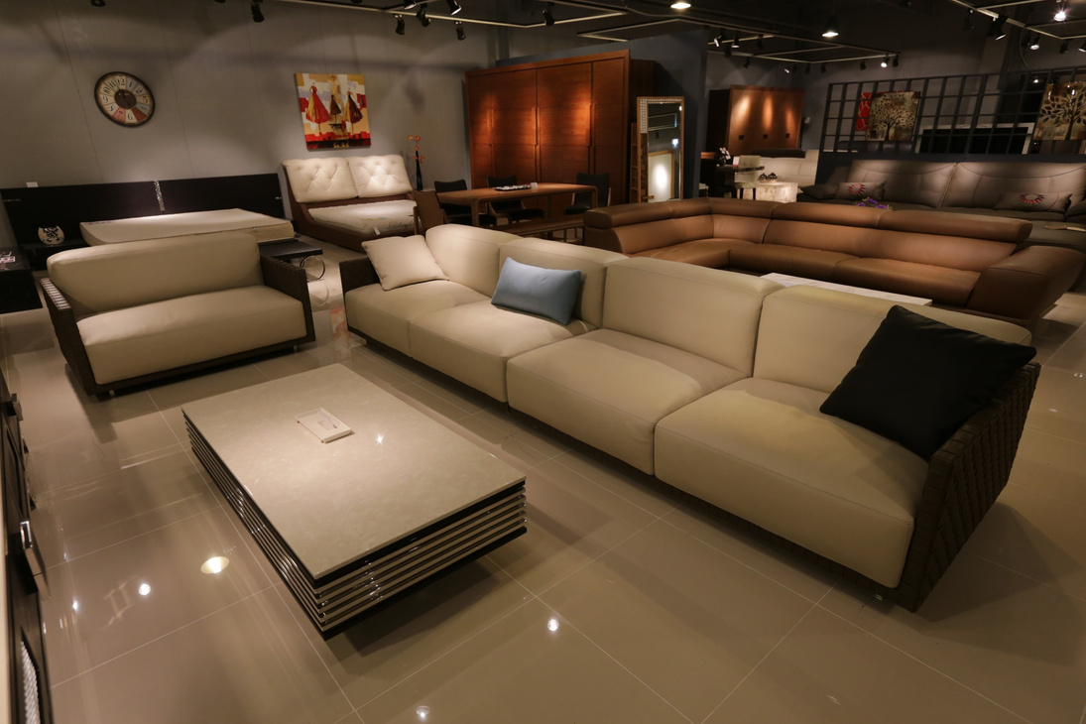
Data Set
6 home samples and 22 parameters

Slide 5

Regression of Interest Rate and Home Price (X & Y Variables)
r -0.009
Slope $(9,813.71)
Intercept $954,101.01
The correlation coefficient, r shows that there is a negative relationship between the bank mortgage rate and home price
Slope: For every unit increase in interest rate, the actual price of the property will go down by $9,813.71
Intercept: If the interest rate is 0%, then the price of the home will be $954,101.01

Slide 6
Income Analysis and Monthly Expense 1/2

Slide 7
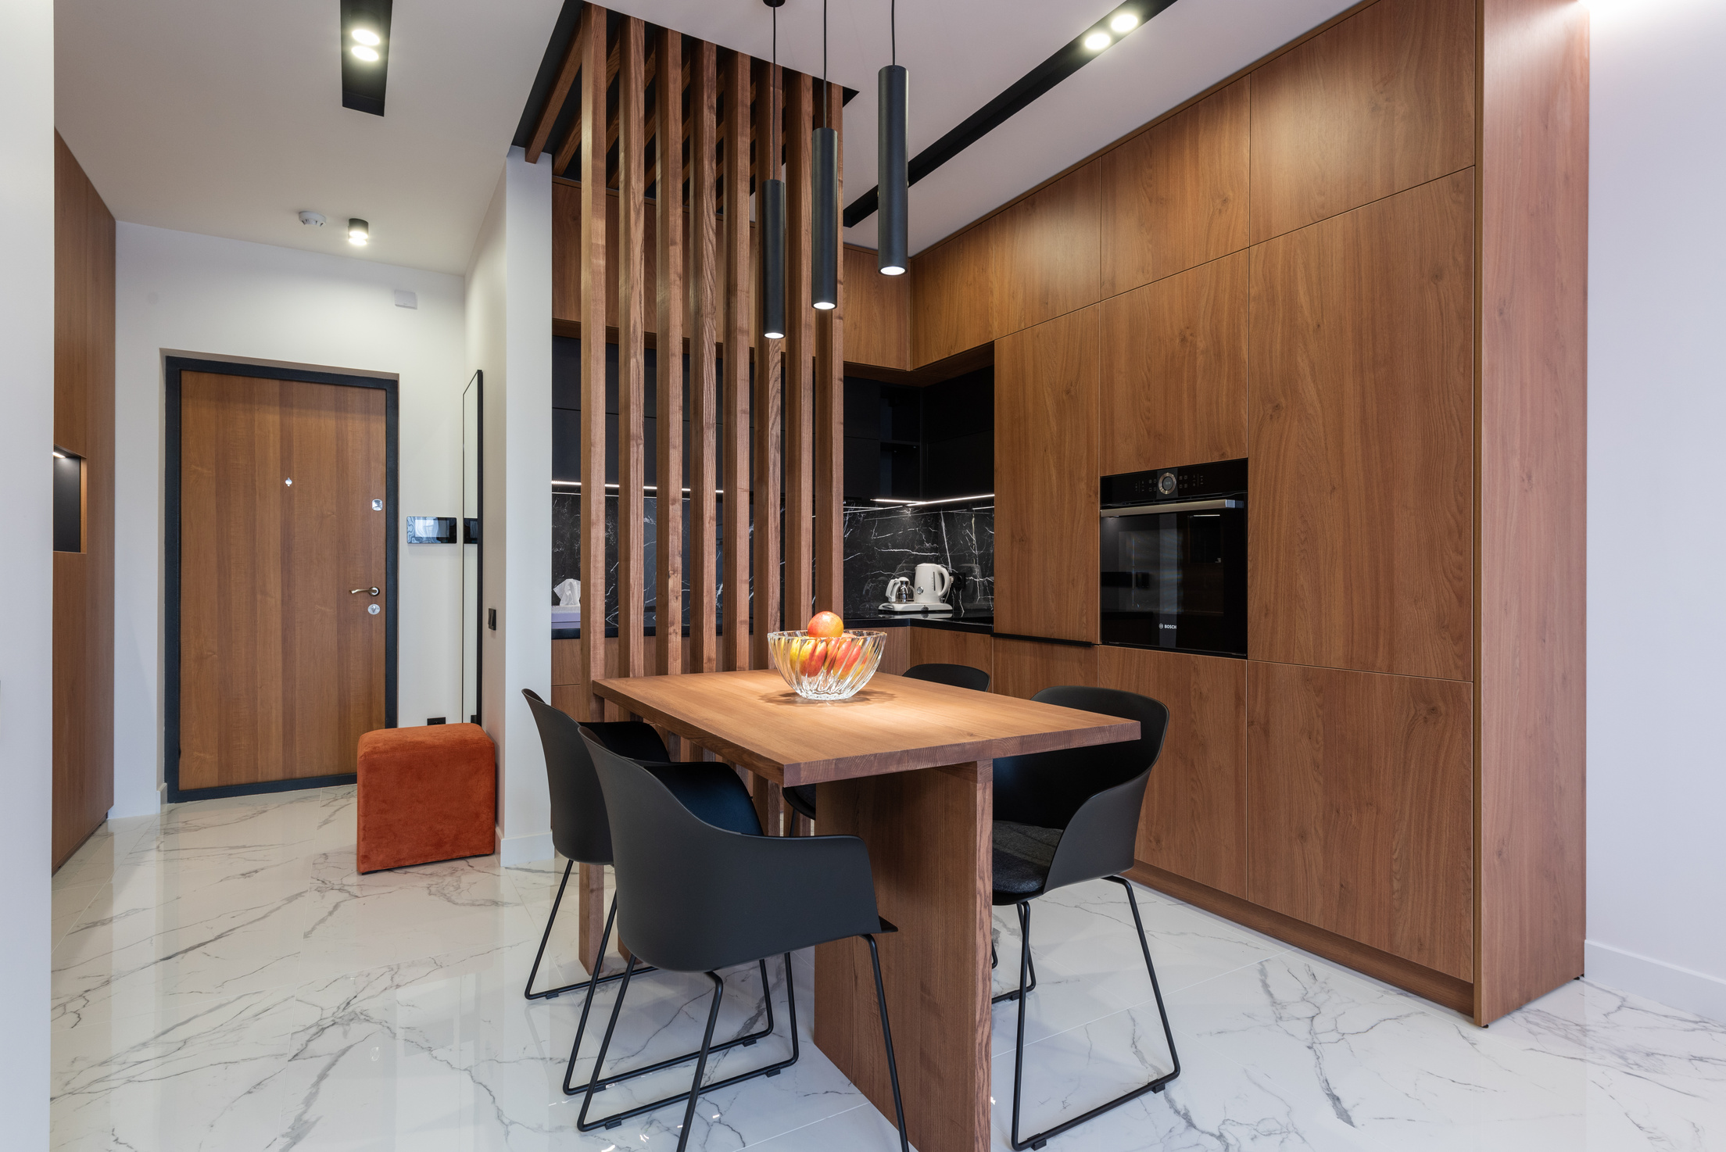
Income Analysis 2/2

Slide 8
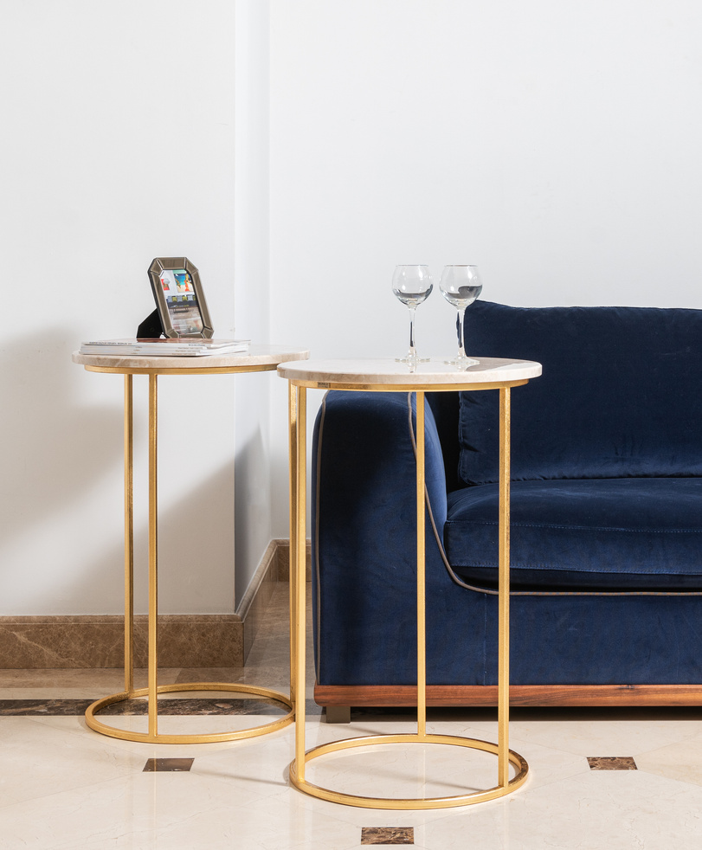
Bank Mortgage Rate Comparison
Preferred bank is BMO. Its rate of 4.5% is within our budget

Slide 9
Monthly Mortgage Payment

Slide 10
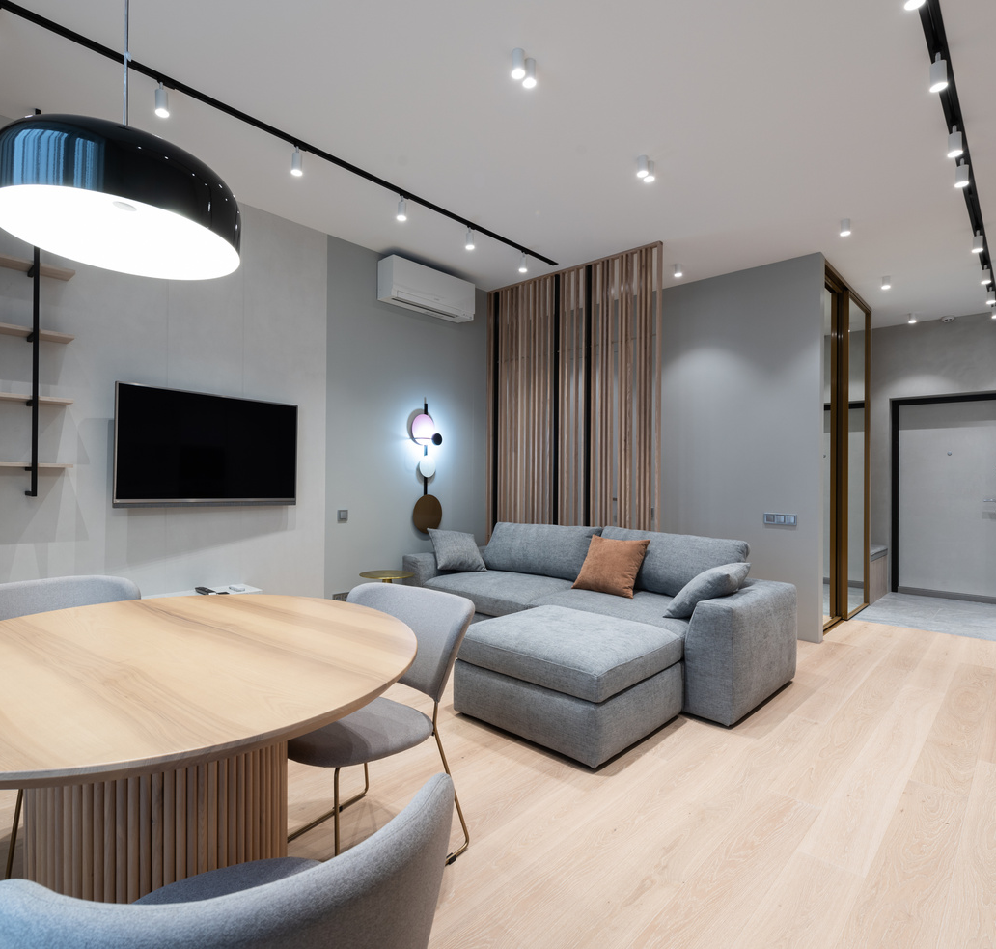
Amortisation Period

Slide 11
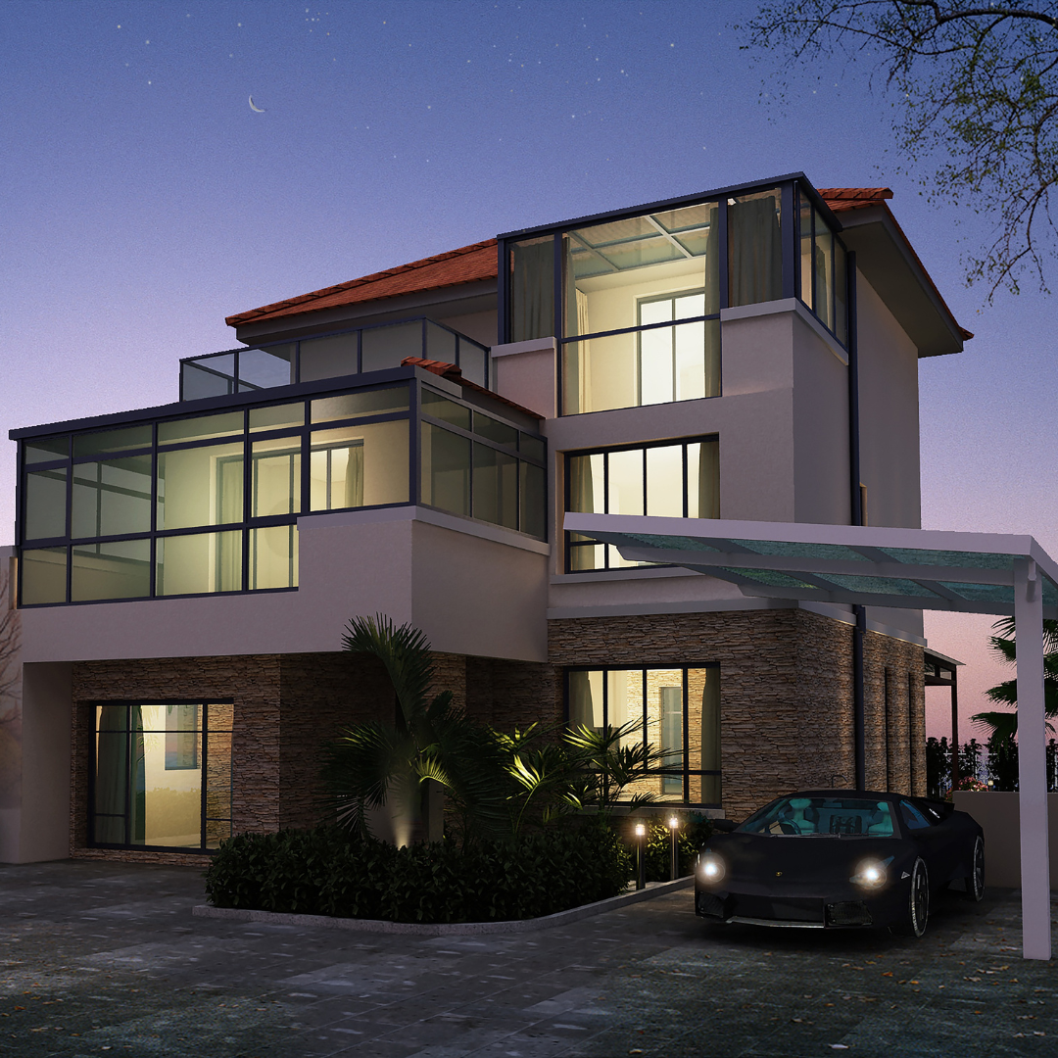
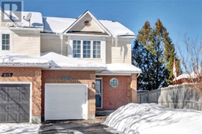
Decision on Dream Home
Met all key preferences
Property Types | Semi Detached
No. of Bedrooms | 3
No. Bathrooms | 3
Exterior Finishing | Aluminium and Brick
Parking Space | 3
Proximity to Public Facilities (Neighbourhood) | Yes, Surb-urban
Purchasing Price | $539,900
Monthly Repayment | $3,073.61
Monthly Property Tax | $267.33
Mortgage Rate | 4.5%
Amortisation Period | 200 months

Slide 12
References
Duplex - https://www.rew.ca/properties/4805115/113-brownville-avenue-toronto-on?search_params%5Bquery%5D=113+Brownville%2C+Toronto%2C+ON+M6N4L2
Duplex -https://www.viewhomes.ca/idx/113-brownville-toronto-on-m6n4l2/19041356_spid/
Triplex -https://www.ojohome.ca/toronto-on/166-van-dusen-blvd-toronto-on-m8z-3h3/pid_s726tvaot1/
https://www.realtor.ca/real-estate/25129134/2793-st-stephens-street-ottawa-fairfield-heights#view=calc
https://www.realtor.ca/real-estate/25242075/817-star-private-ottawa-hazeldean
https://fairsquare.ca/on/ottawa-and-surrounding-area/embrun/home-for-sale/hab-1214-ste-marie-road-d25260578#description

Slide 13
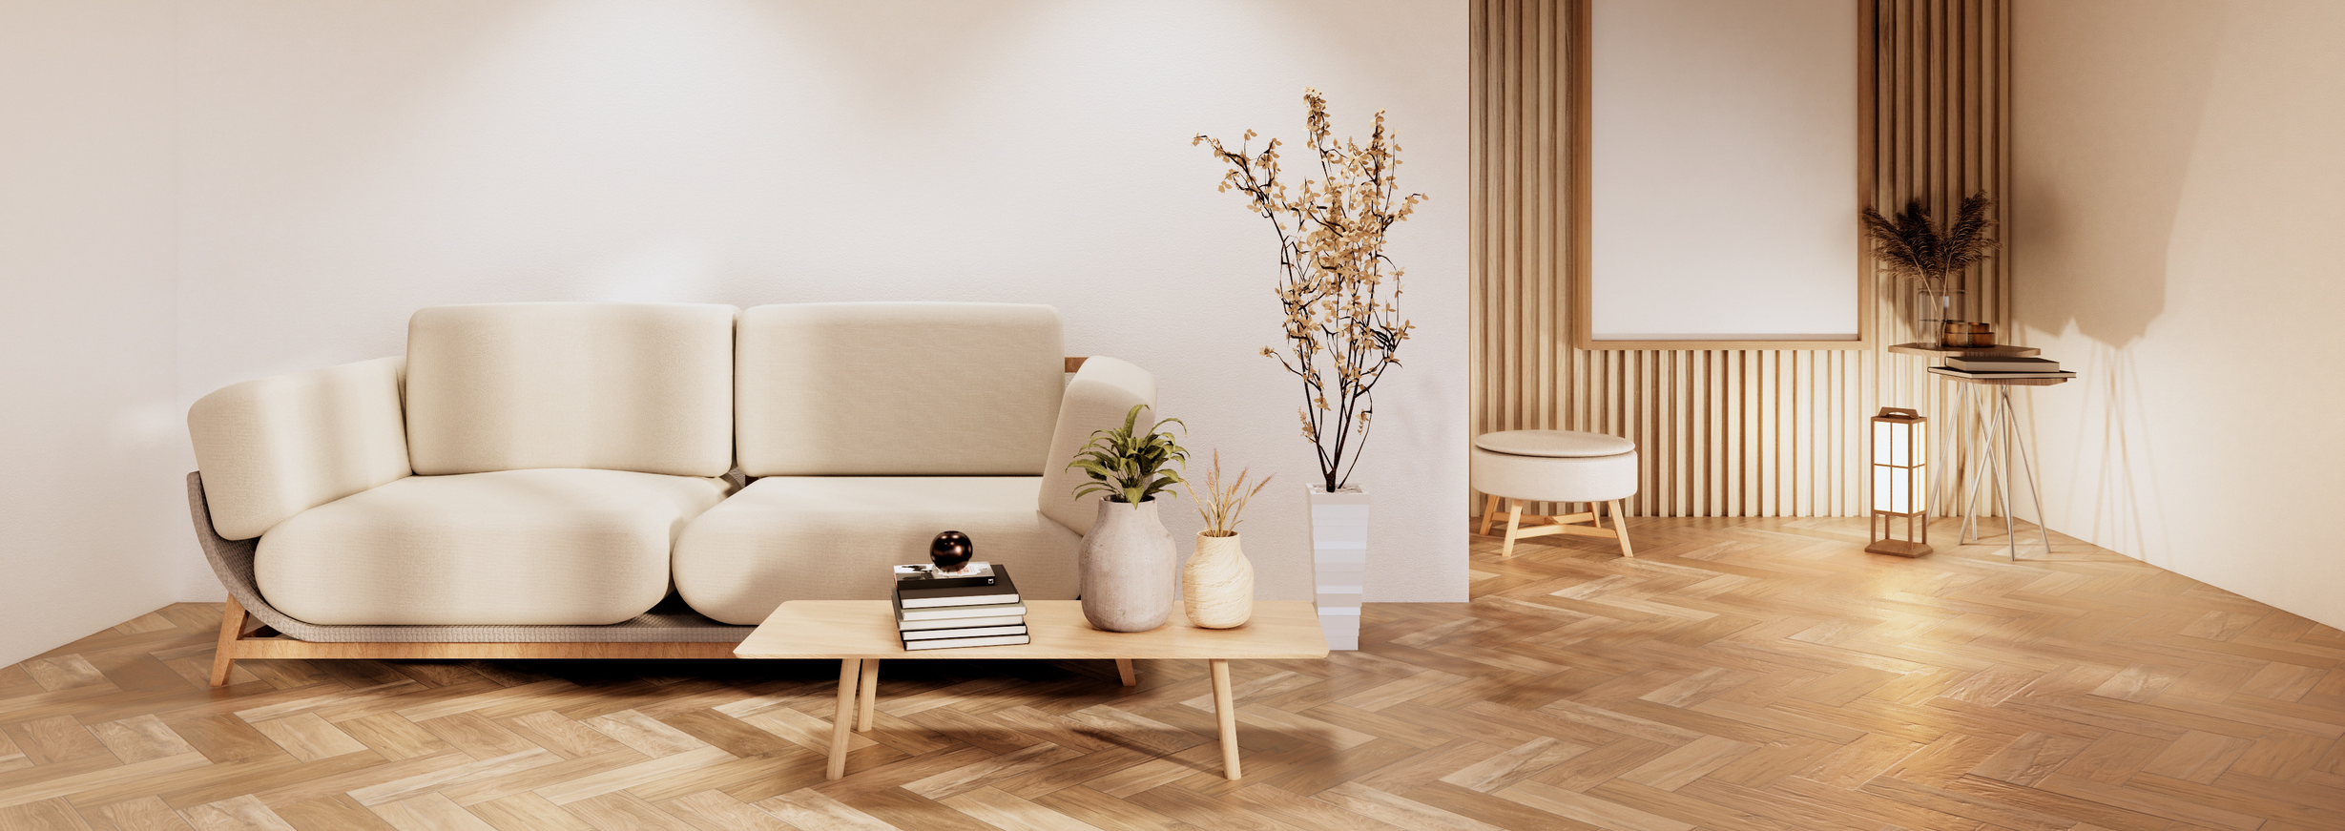


THANK YOU!

